Slide 1

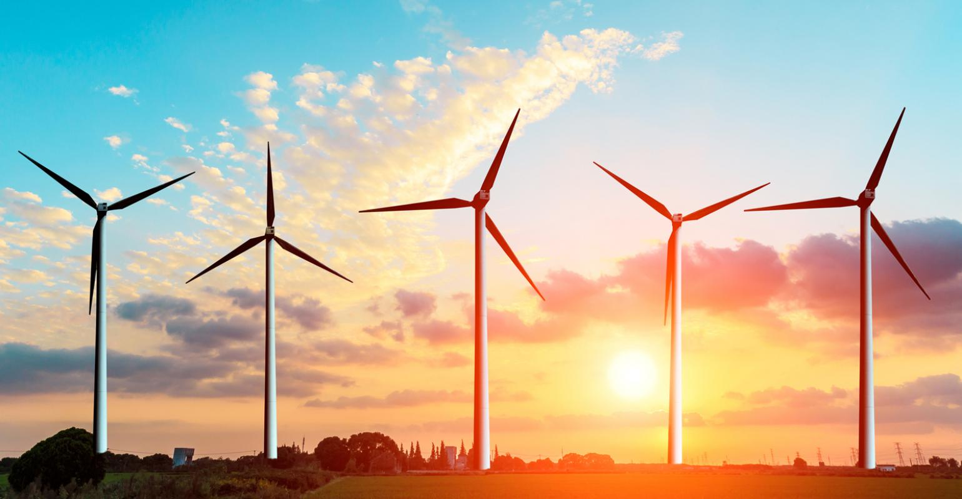
Utilizing unused renewable energy

Slide 2
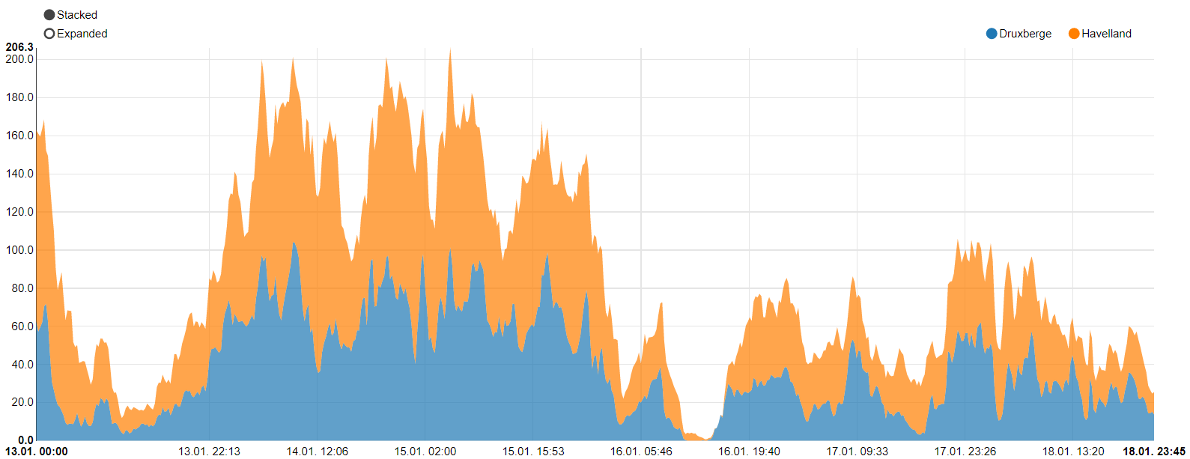

Problem
Power production is inconsistent
Excess energy is generated
Power (MWh)
Figure 1: Peaks and lows of onshore wind power plants in Germany
Source: https://www.energy-charts.de/power.htm?source=wind-onshore&year=2020&week=3
Rocket Science // Moritz, Kai, Annabelle, Lennart, Christian

Slide 3
Energy storage systems
Possible solution?
Which system fits best?
Vehicle to grid
Power-to-Gas
Hydrogen
Excess energy
Battery storage system
Pumped storage hydropower
Rocket Science // Moritz, Kai, Annabelle, Lennart, Christian

Slide 4
Framework
Cost
Efficiency
Safety
Scalability
Technical Feasibility

Slide 5
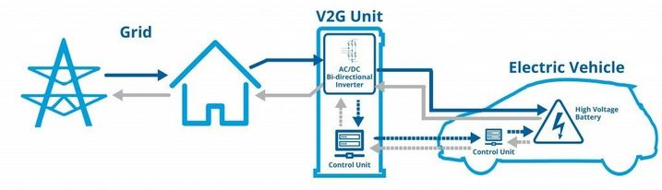
Vehicle to grid
Rocket Science // Moritz, Kai, Annabelle, Lennart, Christian

Slide 6
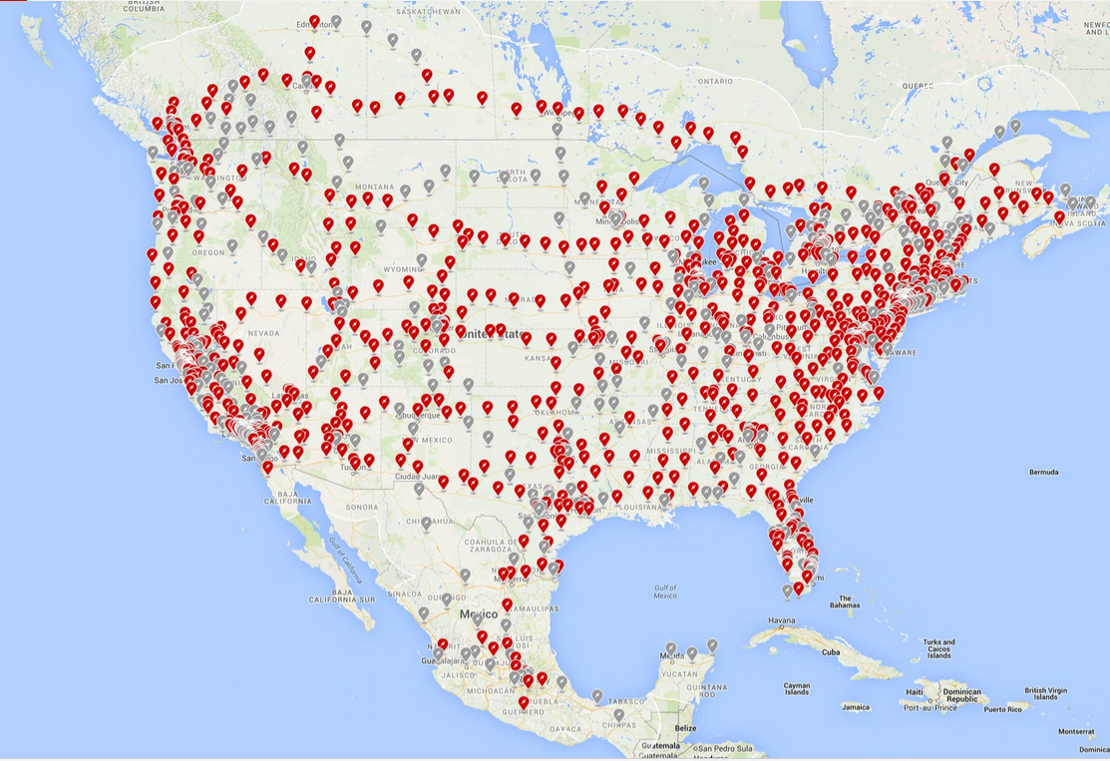
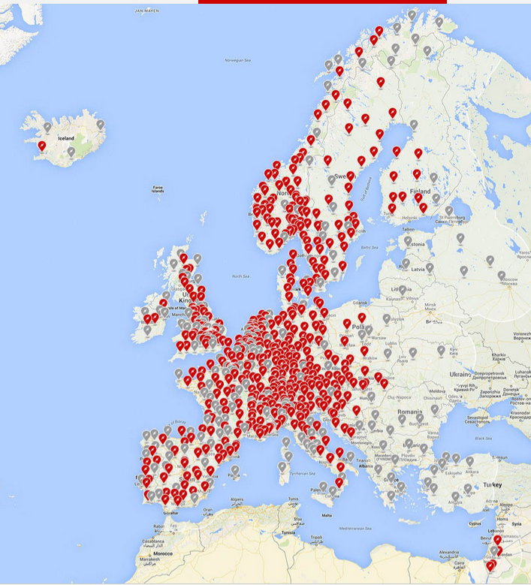
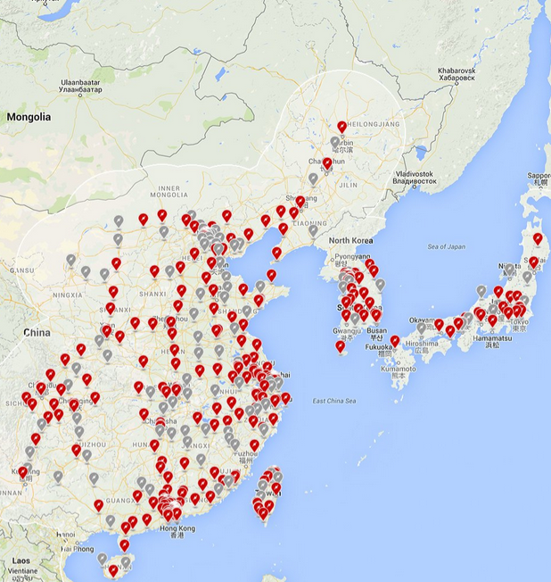
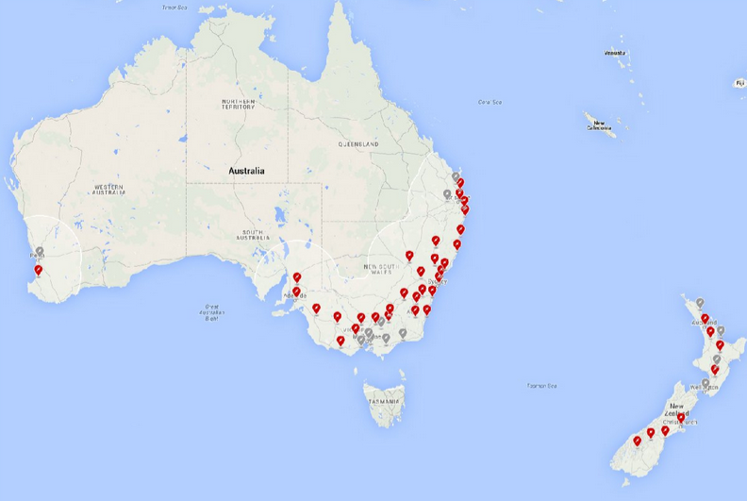
Vehicle to grid
Rocket Science // Moritz, Kai, Annabelle, Lennart, Christian

Slide 7
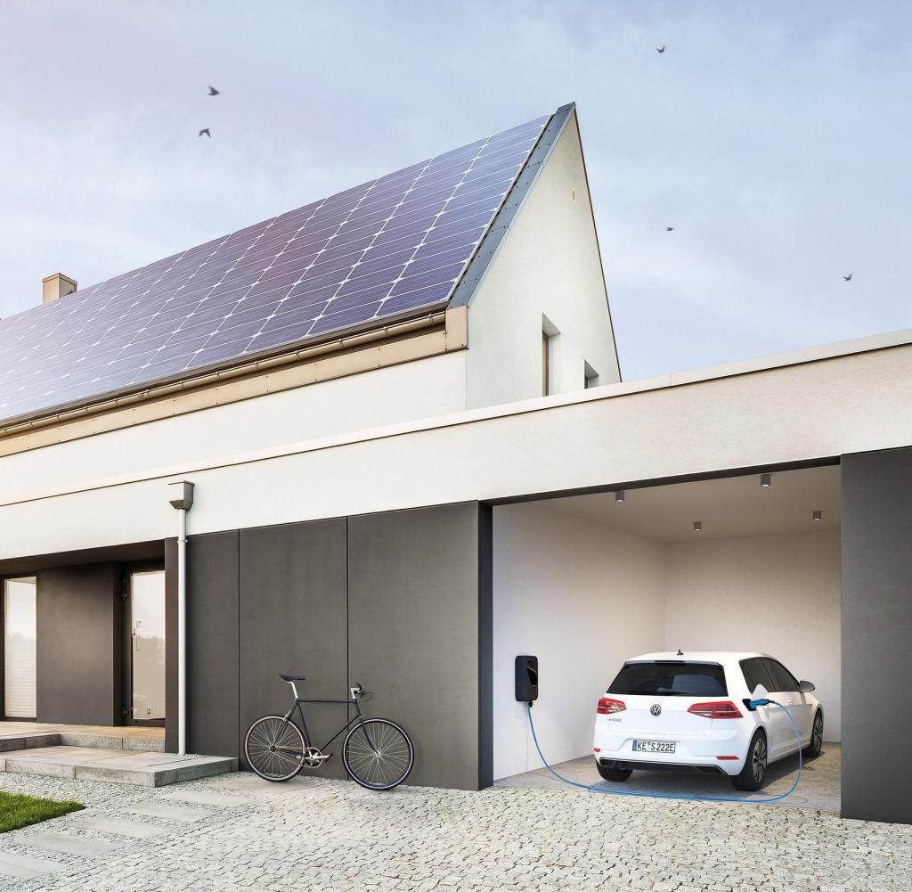
Vehicle to grid
Rocket Science // Moritz, Kai, Annabelle, Lennart, Christian

Slide 8
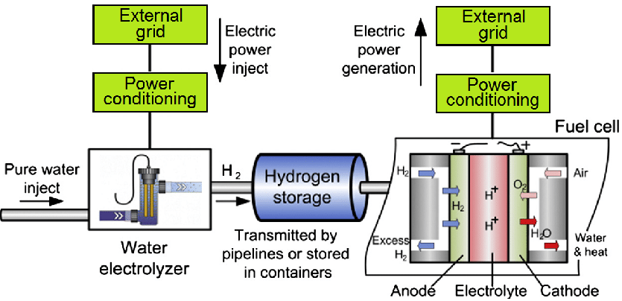
Hydrogen as an energy storage system
Source:https://www.researchgate.net/figure/Topology-of-hydrogen-storage-system-electrolyser-storage-vessel-and-fuel-cell-after_fig1_311679888
Rocket Science // Moritz, Kai, Annabelle, Lennart, Christian

Slide 9
Hydrogen as an energy storage system
Lifecycle: 30 to 45 years
45% round-trip efficiency
Disadvantages
Costly
Inefficient
Advantages
Power and Energy are independtly scalable
Hydrogen production enables further usage

Slide 10
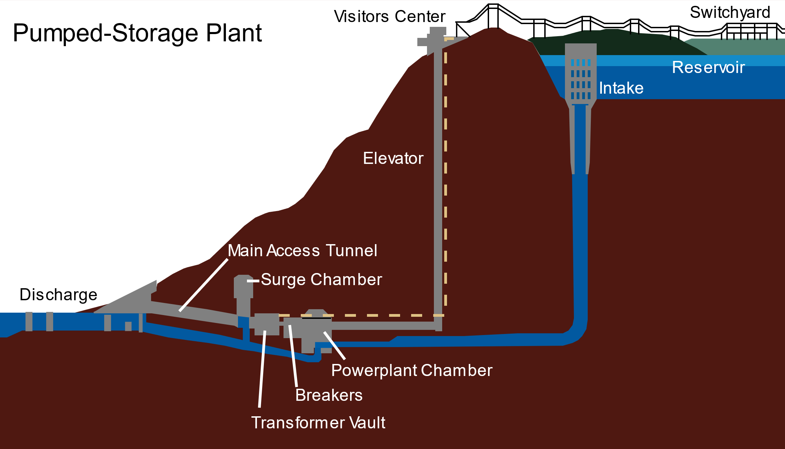
Pumped storage hydropower
Source: https://en.wikipedia.org/wiki/Pumped-storage_hydroelectricity
Rocket Science // Moritz, Kai, Annabelle, Lennart, Christian

Slide 11
Pumped storage hydropower
Lifecycle 20 to 50 years
Issue: Suitable terrain
Elevation
Water availability
New technology

Slide 12
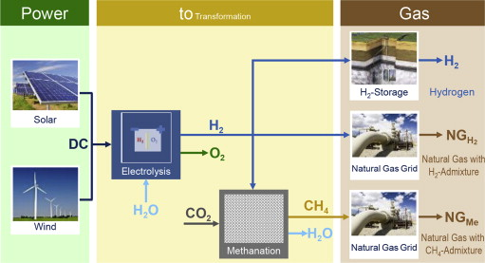
Power-to-Gas
Figure X: Power-to-Gas concepts
Rocket Science // Moritz, Kai, Annabelle, Lennart, Christian

Slide 13
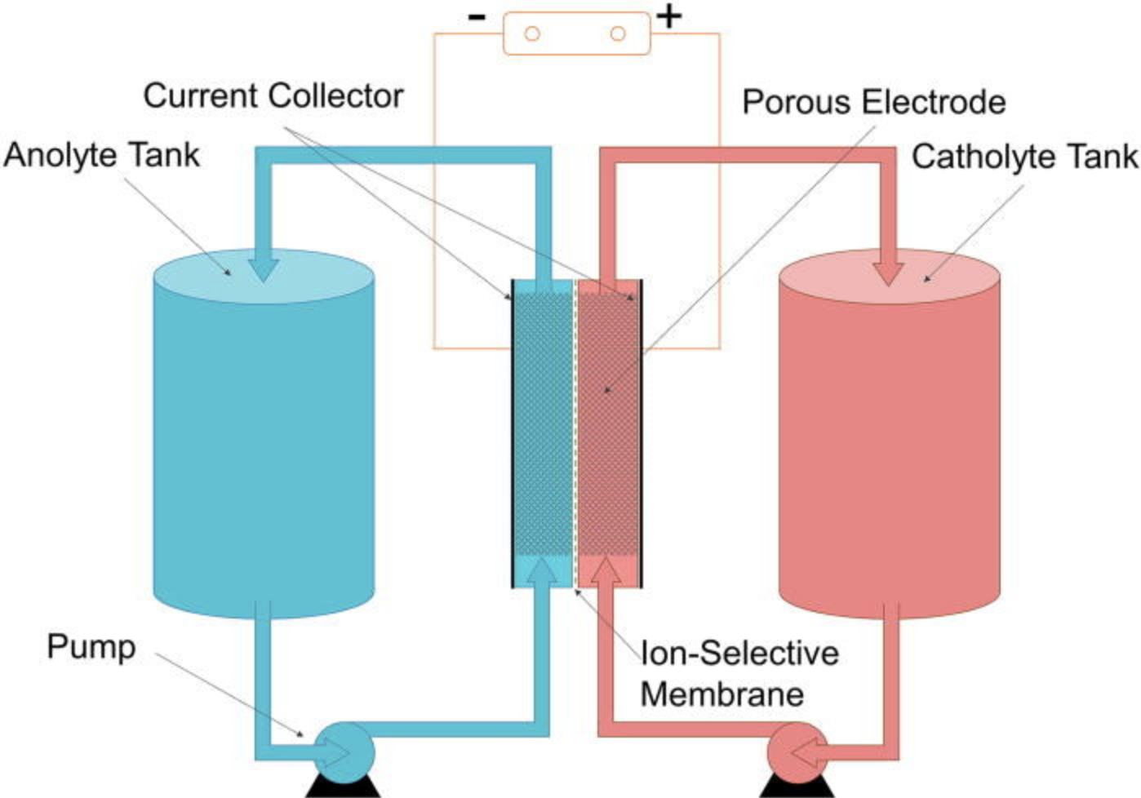
Batteries
Vanadium Redox Flow Battery
Source: https://en.wikipedia.org/wiki/Vanadium_redox_battery#/media/File:Redox_Flow_Battery.jpg
Rocket Science // Moritz, Kai, Annabelle, Lennart, Christian

Slide 14
Vanadium Redox Flow Battery
12,000-20,000 cycle life (90% capacity drop)
330-970 €/kWh
75% efficiency
Disadvantages
Toxic chemicals
Early stage in development
Advantages
Power and energy are separated
Discharge up to 20h

Slide 15
Comparison
Criteria
 | Cost | Efficiency | Safety | Scalability | Technical feasibility
Vehicle to grid | - - - | + | + + + | - - | - - -
Pumped storage hydropower | + | + + + | + + | + + | - -
Hydrogen | - - | - - - | + + | + + + | + + +
Power-to-Gas | - - | + | + + | + + + | + + +
Batteries | + + + | + + | + + | + + + | + +
Systems
Table 1: Comparison between energy storage systems
Rocket Science // Moritz, Kai, Annabelle, Lennart, Christian

Slide 16

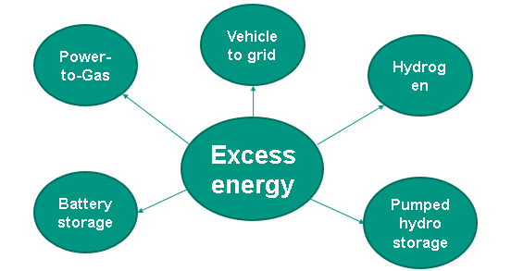
Conclusion
Various technologies technically feasible and scalable
Overall best solution → Battery storage
Rocket Science // Moritz, Kai, Annabelle, Lennart, Christian

Slide 17
Recommendations
Construction of Battery Storage Facilities as soon as possible
Best current solution
Rapid developments into Hydrogen could substitute Batteries in the future
Rocket Science // Moritz, Kai, Annabelle, Lennart, Christian

